Slide 1
FAMILY PLANNING Program
Methods, counseling and MTP services
Dr Nisha Singh
Prof and Unit Head,
I/C Genital cancer control unit
Dept of Obst & Gyne
King George’s Medical University Lucknow

Slide 2
Introduction
Family Planning- A term given to pre-pregnancy planning and action to delay, prevent or actualize a pregnancy.
As per WHO, the objectives of Family planning are-
Avoid unwanted birth
Bring about wanted birth
Regulate the number of pregnancies
Regulate the intervals between pregnancies
Control time at which birth occurs

Slide 3
Pregnancy checklist
Before counselling and starting any method
1-Have you abstained from sexual intercourse since last menses or delivery
2-Did the first day of menses start within past 7 days (within 12 days for IUCD)
4-Had a miscarriage in last 7 days (within 12 days for IUCD)
3-Had a baby in last 4 weeks
4- Have a Baby less than 6 months old but Menses have not returned after last childbirth and Baby isfully breast fed
6-Using reliable contraceptive method correctly
If answer is “Yes” to at least one of the questions with no sign or symptom of pregnancy-give the method chosen
If the answer is “No” ,pregnancy cannot be ruled out - Wait for next menses or do a Urine pregnancy test

Slide 4
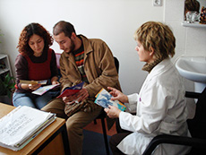
Counselling
1-General counselling-Provider helps a client select a family planning method:
Display all the methods using charts/posters
Arrange by method type-Spacing and limiting method
Set aside methods that are not appropriate
2-Counselling for special group- young age, women, clients affected by gender based violence
3-Method specific counselling- Give information about the methods not set aside and determine MEC for the chosen method. Follow up instructions
4-Follow up counselling- Discuss problem, side effects and manage if any and ensure continuation

Slide 5
GATHER APPROACH
How to conduct the counseling session-
Greet
Ask
Tell
Help
E
Repeat

Slide 6
CAFETERIA APPROCH

Slide 7
Contraceptive methods
Spacing/Temporary Methods
1-Natural method / Family awareness based method
2-Barrier methods - Mechanical- Condoms, Diaphragms, Cervical cap Chemical –spermicidal cream, jelly Combined
3-Hormononal Method
4-Intrauterine devices
Limiting/Permanent Method Sterilization-Male sterilization Female sterilization

Slide 8
NATURAL METHODS
Based on body physiology of ovulation and changes that occur in body during various phases of menstrual cycle
No introduction of any foreign object or chemical into the body
Effectiveness varies greatly, based on couples ability to follow the proper timing
Failure rates are high but poses no side effect on the user and fetus.

Slide 9
Types of natural family planning methods
1- Rhythm( calender method)
2- Basal body temperature(BBT)
3- Ovulation or cervical mucus method
4- Symptothermal method
5- Coitus interruptus
6-LAM (lactational amenorrhea)

Slide 10
Barrier contraceptives
CONDOMS(Male & Female)
Only contraceptive method that can protect against both pregnancy and sexually transmitted infections.
All men and women can safely use latex condoms except those with- Severe allergic reaction to latex rubber
2. DIAPHRAGMS
3. SPERMICIDES
4. CERVICAL CAP

Slide 11
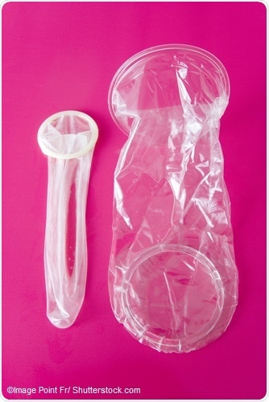
MALE CONDOMS | FEMALE CONDOMS
Made of thin latex rubber (mostly). other materials- polyurethane, polyisoprene, lambskin, and nitrile. | Made of various materials, such as latex, polyurethane, and nitrile
Effectiveness: Commonly used-13 pregnancies /HWY Correctly used- 2 pregnancies/HWY | Effectiveness: Commonly used- 21 pregnancies /HWY Correctly used- 5 pregnancies/HWY
How to Use Before the penis makes any genital, oral, or anal contact. Immediately after ejaculation, slide it off | Can be inserted upto 8 hrs before sex Doesn’t need to be removed immediately after sex
Lubricants for latex condoms- natural vaginal secretions, or made of Silicone/ water/ Glycol

Slide 12
Diaphragms
A soft latex cup that covers the cervix. Plastic and silicone diaphragms may also be available. (come in different sizes)
The rim contains a firm, ﬂexible spring that keeps the diaphragm in place.
Used with spermicidal cream, jelly, or foam to improve effectiveness
Effectiveness:
Commonly used- about 17 pregnancies /HWY
Correctly used- about 16 pregnancies/HWY
Safe for all women. (The diaphragm should not be fitted until 6 weeks after childbirth or second-trimester abortion, when the uterus and cervix have returned to normal size) except those with HIV, latex allergy.
Inserted <6hrs before sex, leave in place at least for 6hrs after sex but not >24hrs.

Slide 13
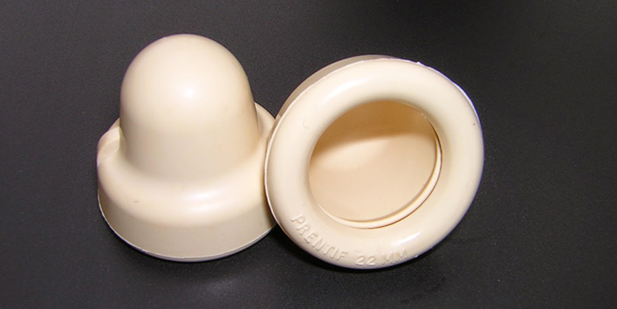
Cervical caps
A soft, deep, latex or plastic rubber cup that snugly covers the cervix.
Comes in different sizes; requires ﬁtting by a speciﬁcally trained provider
Insert anytime upto 42hrs before sex,
leave in for at least 6hrs but not > 48hrs.
Effectiveness | Commonly used | Correctly used
Who have given birth | 32 preg /HWY | 26preg /HWY
Who have not given birth | 16 preg /HWY | 9 preg /HWY

Slide 14
Spermicides
Nonoxynol-9 is most widely used.
Others- benzalkonium chloride, chlorhexidine, menfegol, octoxynol-9, and sodium docusate.
Can be used alone, with a diaphragm, or with condoms.
Inserted deep in the vagina, near the cervix, before sex.
Work by causing the membrane of sperm cells to break, killing them or slowing their movement.
Effectiveness: One of the least effective contraceptive methods.
Commonly used- about 21 pregnancies /HWY
Correctly used- about 16 pregnancies/HWY
Side Effects : Irritation in or around the vagina or penis
All women can safely use spermicides except those who are at high risk for HIV infection or Have HIV infection

Slide 15
Lactational Amenorrhea Method
The LAM requires 3 conditions to be fullfilled.
The mother’s monthly bleeding has not returned.
The baby is fully or nearly fully breastfed and is fed often, day and night.
The baby is less than 6 months old.
“Fully breastfeeding” includes both exclusive breastfeeding (the infant receives no other liquid or food, not even water, in addition to breast milk) and almost-exclusive breastfeeding (the infant receives vitamins, water, juice, or other nutrients once in a while in addition to breast milk).
“Nearly fully breastfeeding” means that the infant receives some liquid or food in addition to breast milk, but the majority of feedings (more than three-fourths of all feeds) are breast milk.

Slide 16
HORMONAL CONTRACEPTIVES
Combines oral contraceptives
Progestin only pills
Emergency contraceptive pills
Progestin-only injectables
Monthly injectables
Combined patch
Combined vaginal ring
Progesterone-releasing vaginal ring
Implants
Composition- Either estrogen and progesterone or only progesterone
Mechanism of Action-
Estrogen - prevents ovulation.
Progesterone- thickening of cervical mucus (reduces sperm motility) and thinning of endometrial lining (unfavourable for implantation)

Slide 17
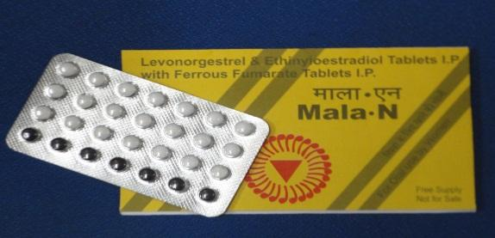
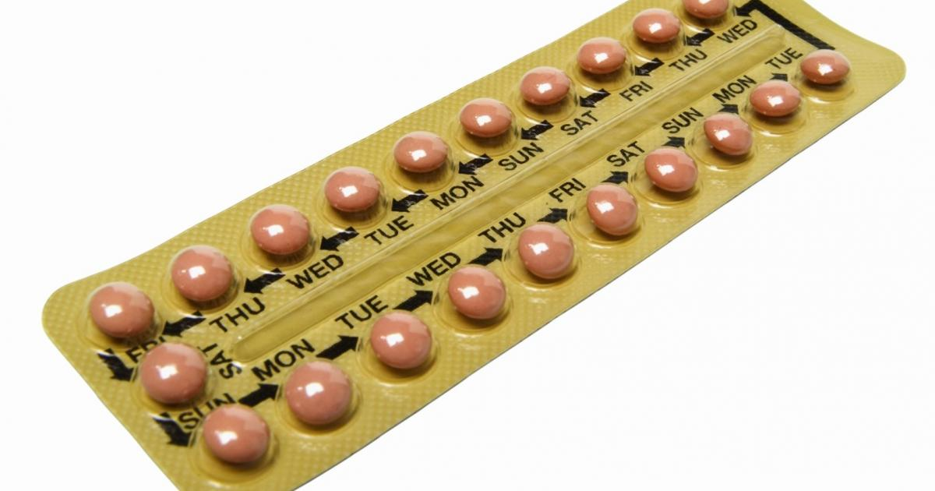
Combined Oral Contraceptives
Health Benefits
Help protect against:
Risks of pregnancy
Endometrial cancer
Cancer of the ovary
Symptomatic pelvic inﬂammatory disease
May help protect against:
Ovarian cysts
Iron-deficiency anemia
Reduce:
Menstrual cramps
Menstrual bleeding problems
Ovulation pain
Excess hair on face or body
Symptoms of polycystic ovarian syndrome (irregular bleeding, acne, excess hair on face or body)
Symptoms of endometriosis (pelvic pain, irregular bleeding)
Health Risks
Very rare:
Blood clot in deep veins of legs or lungs (deep vein thrombosis or pulmonary embolism)
Extremely rare:
Stroke
Heart attack

Slide 18
How to Use
28-pill packs: Start from D1 of cycle. Start the next pack the very next day If started after 5 days of start of bleeding , will need a backup method for 7days Post abortal - start soon after Exclusive breast feeding - start after 6 months of childbirth Partial breast feeding -After 6weeks of childbirth. If her monthly bleeding has not returned, will need a backup method for the first 7 days of taking pills Not breast feeding-Anytime on days 21-28 after giving birth
21-pill packs: start on D1 of cycle. After the last pill from one pack, wait 7 days for onset of periods and then take the first pill from the next pack.
Pearl index-
Perfect use- 0. 3pregnancy/ HWY
Typical use- 8 pregnancy/HWY
No delay in return of fertility after COCs are stopped.
No protection against sexually transmitted infections (STIs).

Slide 19
If a woman misses one or more pills:-
Missed 1 or 2 pills? Started new pack 1 or 2 days late? | Take a hormonal pill as soon as possible. Little or no risk of pregnancy.
Missed pills 3 or more days in a row in the ﬁrst or second week? Started new pack 3 or more days late? | Take a hormonal pill as soon as possible and continue the scheduled pill Use a backup method for the next 7 days. Also, if she had sex in the past 5 days, she can consider ECPs within 72 hours
Missed 3 or more pills in the third week? | Take a hormonal pill as soon as possible. Finish all hormonal pills in the pack. Throw away the 7 non hormonal pills in a 28-pill pack. Start a new pack the next day. Use a backup method for the next 7 days. Also, if she had sex in the past 5 days, she can consider ECPs
Missed any non- hormonal pills? (last 7 pills in 28-pill pack) | Discard the missed non hormonal pill(s). Keep taking COCs, one each day. Start the new pack as usual.
If she vomits within 2 hours after taking a pill, she should take another pill from her pack as soon as possible, then keep taking pills as usual.
If she has vomiting or diarrhoea for more than 2 days, follow instructions for 3 or more missed pills, above.(GOI-1 or 2 missed pills schedule)

Slide 20
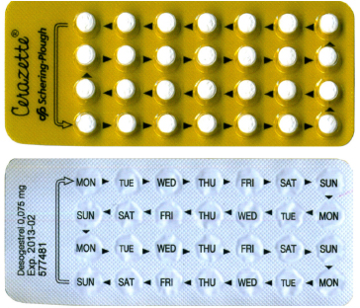
Progestin Only Pills(POPs)
Also called “minipills”. Safe in breast feeding
Pearl Index- Perfect use Typical use
Breastfeeding- 0.3preg/HWY 1preg/HWY
Non breastfeeding- 0.9 pre/HWY 3-10preg/HWY
Usage - One pill each day at the same time every day
All pills are the same color, all are active pills,
28 pills pack or 35pills pack
A woman can start using POPs any time if it is reasonably certain she is not pregnant.

Slide 21
If a woman misses one or more pills:-
If a woman is 3 or more hours late taking a pill (12 or more hours late taking a POP containing desogestrel 75 mg), or if she misses a pill completely If monthly bleeding have returned | Take a hormonal pill as soon as possible. Can take 2 pills at the same time or same day. Little or no risk of pregnancy. Use backup method for 2days Also, if she had sex in the past 5 days, she can consider ECPs(GOI-72hrs)
If she vomits within 2 hours after taking a pill, she should take another pill from her pack as soon as possible, then keep taking pills as usual.

Slide 22
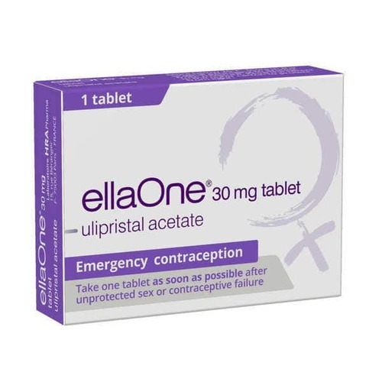
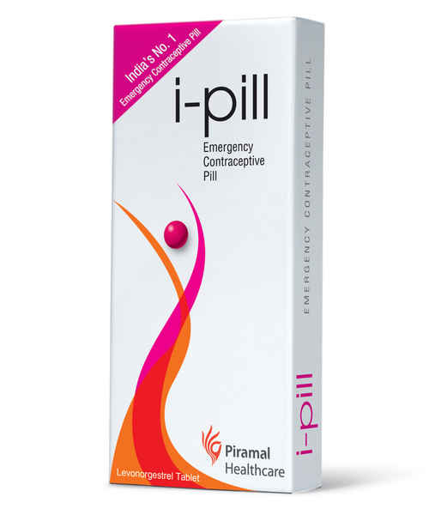
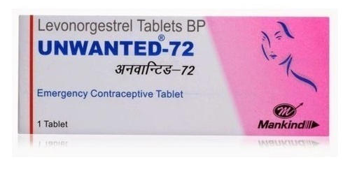
Emergency Contraceptive Pills(ECPs)
Also called “morning after” pills or post coital contraceptives.
Help a woman avoid pregnancy after she has sex without contraception.
Do not disrupt an existing pregnancy.
Pills available as ECPs
A special ECP product with Levonorgestrel only or
Ulipristal Acetate (UPA)
• Combined oral contraceptives with estrogen and a progestin— levonorgestrel, norgestrel, norethindrone/ norethisterone)
Progestin-only pills with levonorgestrel or norgestrel

Slide 23
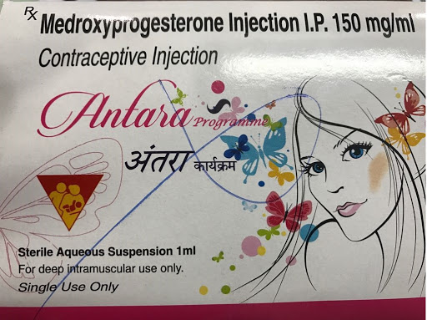
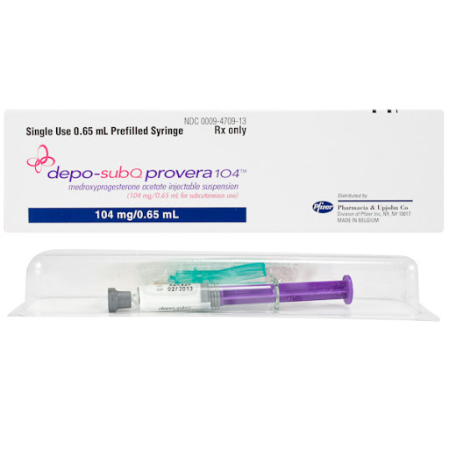
Progestin Only Injectables
DMPA- Most widely used progestin-only injectable
17 alpha OH-progesterone derivative- progestin MPA
Intramuscular form (150mg) known as “the shot,” “the jab,”
Depo, Depo-Provera, and Petogen.
The subcutaneous version (104mg) is available in two forms
prefilled auto disable syringe in the Uniject injection system, currently marketed under the name Sayana Press
preﬁlled single-dose disposable conventional syringes as Depo sub Q provera 104
NET-EN (200mg) - Norethindrone enanthate,
Noristerat, Norigest and Syngestal
Start during D1-7 of periods and after 6 weeks of childbirth if breastfeeding. Repeat every 2 months
Pearl Index
Typical use - 4preg/ HWY
Perfect use- 0.3 preg/HWYs
Return of fertility after injections are stopped: An average of about 4 months longer for DMPA and 1 month longer for NET-EN than with most other methods

Slide 24
Monthly Injectables(Combined Injectable Contraceptives, CICs)
Contains a progestin and an estrogen. MOA- ovulation inhibition
1.MPA/estradiol cypionate (25mg) - Ciclofemina, Cyclofem, Cyclo-Provera, Feminena, Lunella, Lunelle, and Novafem.
2.NET-EN/estradiol valerate(50mg)- Mesigyna and Norigynon.
Pearl Index-
Typical use- 3preg /HWY Perfect use- <1 preg/HWY
Return of fertility after injections are stopped: An average of about 5 months

Slide 25
Combined Patch
A small, thin, square of ﬂexible plastic worn on the body. Which continuously releases—a progestin and an estrogen.
Ortho Evra and Evra.
Effectiveness :Typical use-7preg/HWY Perfect use-<1 preg/HWY
No delay in return of fertility
How to Use-
New patch every week for 3 weeks, then no patch for the fourth week. During this fourth week the woman will have monthly bleeding
Can apply it on the upper outer arm, back, stomach, abdomen, or buttocks, wherever it is clean and dry, but not on the breasts
Forgot to apply a new one- Apply a new patch as soon as possible.
If late by only 1 or 2 days, no need for a backup method.

Slide 26
Wearing the Patch

Slide 27
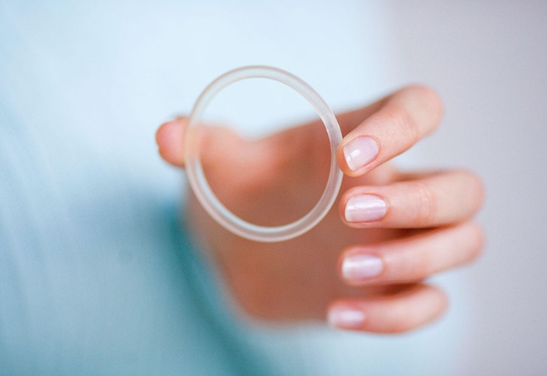
Combined Vaginal Ring
A ﬂexible ring in the vagina, that continuously releases a progestin and an estrogen - NuvaRing
The ring is in place for 3 weeks, removed in the fourth week for menstruation.
Effectiveness-Typical use - 7 preg / HWY Perfect use <1 preg / HWY
If left out >48hrs, then backup method for 7days | The ring can be removed for sex, cleaning, or other reasons, although removing it is not necessary. If the ring slips out, she should rinse it in clean water and immediately reinsert it.
Kept ring in longer than 3 weeks? | If the same ring is used for up to 4 weeks, no backup method is needed. She can take a ring-free week or start a new ring immediately. If the same ring is used for more than 4 weeks but less than 5 weeks, insert a new ring and skip the ring-free week. No backup.

Slide 28
Progesterone Releasing Vaginal Ring
A smooth, soft, ﬂexible ring placed in the vagina. Continuously releases natural progesterone hormone
Suitable for postpartum women who are actively breastfeeding, at least 4 times per day.
When to Use: 4 to 9 weeks after giving birth
-Each ring is kept in place for 90 days. The woman can then replace it with a new ring immediately. Up to 4 rings can be used, one after another, with no breaks
-The ring should never be left out for more than 2 hours
-If left for >24 hours-Put the ring back as soon as possible-use condom if woman has sex in next 48 hours
Effectiveness: 2 preg/HWY

Slide 29
Implants
Small plastic rods, that release progestin
A specifically trained provider performs a minor surgical procedure to place one or 2 rods under the skin on the inside of a woman’s upper arm.
Effective-<1 pregHWY
Name | No. of Rods | Composition | Effectiveness
Jadella | 2 | Levonorgestrel | 5yrs
Implanon NXT (Nexplanon) | 1 | Etonogestrel | 3yrs
Levoplant (Sino-Implant II) | 2 | Levonorgestrel | 4yrs
Norplant (discontinued in 2008) | 6 | Levonorgestrel | 5-7yrs
Do not contain estrogen, and so can be used throughout breastfeeding and by women who cannot use methods with estrogen.

Slide 30
Centchroman
Ormeloxifene- non steroidal non hormonal
Selective estrogen receptor modulator(SERM)- antiestrogenic activity on uterus and breast, estrogenic activity on bones
Effectiveness-1-2 preg /HWY
Government of India supply - Chhaya
How to start
First pill (30mg)- on the first day of menses and second pill three days later for first three months.
From fourth month - once a week from the first pill day, continued weekly regardless of her menstrual schedule
-Safe for breast feeding women.

Slide 31
INTRAUTERINE DEVICES(IUD)
COPPER BEARING
IUDs
LEVONORGESTREL IUDs

Slide 32
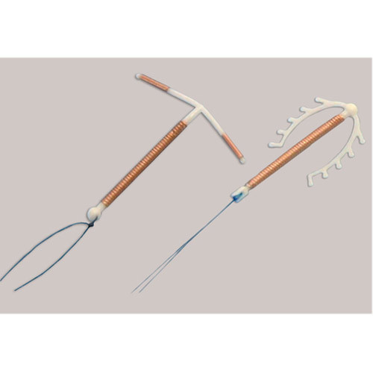
Copper Bearing IUDs(Cu-IUDs)
Small, ﬂexible plastic frame with copper sleeves or wire around it, have one or two strings or threads tied to them.
Mechanism of action: Cause a chemical change that prevents implantation
Effectiveness:<1 preg/HWY
Return of fertility after IUD is removed: no delay
Benefits
Is one time insertion - long-lasting
Is private, not seen or known
Has no further costs for supplies after the IUD is inserted

Slide 33
Side Effects:
Changes in bleeding patterns (first 3 to 6 months) -Prolonged and heavy monthly bleeding, Irregular bleeding. More cramps and pain during monthly bleeding
Contraindications:
Between 48 hours and 4 weeks since giving birth
Gestational trophoblastic disease
Cervical, Endometrial, Ovarian cancer
Current PID, very high individual risk for STIs has
severe or advanced HIV clinical disease, SLE with severe thrombocytopenia
Distorted uterine cavity
Known Health Benefits | Known Health Risks | Complications
May help protect against Endometrial cancer Cervical cancer | Uncommon anemia if a woman already has low iron blood stores before insertion | Rare: Uterine perforation Miscarriage, preterm birth, or infection in the rare case that the woman becomes pregnant with the IUD in place.
Reduces Risk of ectopic pregnancy | Rare Pelvic inﬂammatory disease (PID)

Slide 34
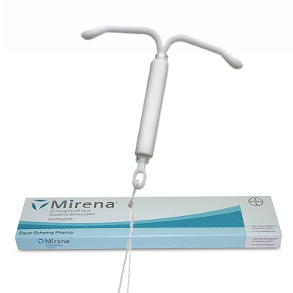
Levonorgestrel Intrauterine Device
T-shaped plastic device - steadily releases levonorgestrel each day.
Mirena, Liletta, Kyleena, Skyla, and Jaydess
Effectiveness -<1 preg/HWY
5 years
Return of fertility after removal: No delay

Slide 35
Family Planning Methods In Post-Partum Period
Family Planning Method | Fully or nearly fully breastfeeding | Partial Breastfeeding or not breastfeeding
Lactational Amenorrhea | Immediately | Not applicable
Male sterilization | Immediately or during partner’s pregnancy
Female sterilization | Within 7days . Otherwise after 6weeks
Combined Oral Contraceptives Monthly injectables Combined patch Combined Vaginal Ring | >6 months | >6weeks
Progestin only pills Implants | Immediately
Progestin only injectables | > 6weeks

Slide 36
Family Planning Method | Fully or nearly fully breastfeeding | Partial Breastfeeding or not breastfeeding
Progesterone Releasing Vaginal ring | After 4 to 9 weeks | If breastfeeding atleast 4times a day, start at 4-9 weeks Not breastfeeding: doesn’t apply
IUDs | Within 48hrs. Otherwise after 4 weeks(GOI-4weeks)
Male or Female Condoms Spermicides | Immediately
Diaphragm | After 6 weeks
Fertility awareness methods Symptoms based methods Calender based methods | When normal secretions have returned When she had 3 regular menstrual cycles

Slide 38
Comprehensive Abortion Care
Training and Service Delivery Guidelines,2018
Ministry of Health and Family Welfare Government of India

Slide 39
Policies for Safe Abortion Care
National Population Policy (NPP) 2000 and the Reproductive and Child Health-II (RCH), National Health Mission (NHM) programme, within the framework of the MTP Act, 1971.
A) Integrated strategic approach under the Reproductive, Maternal, Newborn, Child and Adolescent Health (RMNCH+A)
B) Establishing CAC service : Woman-centred approach
Choice: giving woman the options to choose from the methods for the termination of pregnancy and post-abortion contraception
Access: making services available near her home
Quality care

Slide 40
Counseling
Pre procedure counseling helps the woman to
decide about the termination of pregnancy
choose the method of termination
ensure that the consent for the procedure is given after receiving complete information about the procedure and understanding its implications
adopt a contraceptive method after the procedure
Post-abortion counselling
ensures that the woman has understood the precautions and care needed during the postabortion period and the actions that need to be taken in case of complications
provides an opportunity to counsel for contraception
reinforces the need for continuing the use of the contraceptive method chosen

Slide 41
Methods of 1st trimester abortion
Medical methods
Prostaglandins
Antiprogesterones- Mifepristone
Use of mifepristone (in 2002) and misoprostol (in 2006) was approved for termination of pregnancy up to seven weeks (49 days). A combi pack of 200mg mifepristone and 800mcg misoprostol has been approved by the Central Drugs Standard Control Organisation, DGHS up to nine weeks (63 days) in December 2008.
Surgical methods
Suction & Evacuation
Manual Vacuum Aspiration (MVA)
Electric Vacuum Aspiration (EVA)
Dilatation & curettage (not frequently practiced)

Slide 42
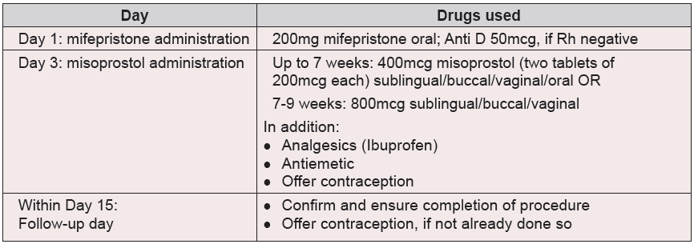
Procedure - MMA

Slide 43
Advantages and Limitations of MMA
Advantages of MMA
Limitations of MMA
Safe procedure with high percentage of success rate in early pregnancy
Offers more privacy
Feasible with minimum technical assistance
Less overall complication rate. No risk of cervical or uterine injury
No instrument and anaesthesia required, hence less invasive
No effect on future fertility, if standard protocol followed
Generally three visits required (if misoprostol is administered at home, a minimum of two visits required)
Whole process takes longer, duration of bleeding can be 8-13 days. However, the bleeding decreases as soon as the POC expulsion process is complete
Drugs used for termination may have side-effects
Potential risk of foetal malformation in cases where pregnancy continues due to the failure of MMA

Slide 44
Complication and Management
Heavy bleeding
(B) Incomplete abortion
(C) Continuation of pregnancy Advisable to terminate a pregnancy surgically ( the risk of possible teratogenicity.)
A written statement, signed by the woman, must be kept on record if surgical termination is refused.
(D) Delay in onset of next menses
Can occur from 3-6 weeks after the abortion and is usually normal.

Slide 45
WHO and FIGO jointly recommend that a properly equipped hospitals should abandon curettage and adopt manual/electric aspiration methods

Slide 46
Indications & Contraindications
Indications
Contraindications
Vacuum aspiration can be used for:
Induced abortion of up to 12 weeks gestation/uterine size
Vacuum aspiration can also be used for:
Incomplete abortion of up to 12 weeks gestation/uterine size
Missed abortion
Hydatidiform Mole of up to 12 weeks gestation/uterine size
Removal of decidua with surgical management of an ectopic pregnancy
Presence of acute cervical, vaginal or pelvic infection. The procedure should only be done under peri-operative antibiotic cover
Suspicion of perforation (from a previous interference in the present pregnancy)
Suspicion of ectopic pregnancy

Slide 47
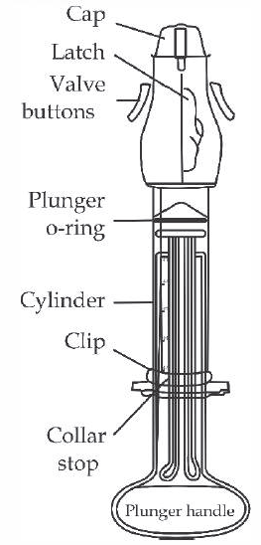
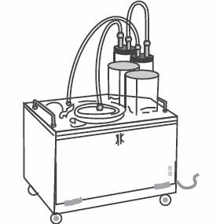
Surgical Methods for 1st trimester
Manual and Electric vacuum aspirator (MVA & EVA)
MVA - handheld plastic aspirator Vacuum source is attached to a cannula. Hand-activated to suction single-valve ( menstrual regulation -MR syringe) double-valve aspirators
EVA uses an electric pump or suction machine attached to a cannula to evacuate uterine contents.
typically used in centralised settings with higher caseloads

Slide 48
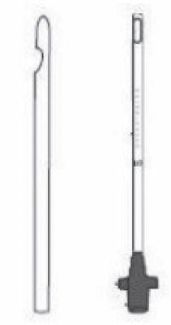
Suction Cannulae
Disposable, single-use cannula (Karman)
Autoclavable, reusable cannula (EasyGrip)
Uterine Size | Preferred Cannula Size
4-6 weeks LMP | 4-6mm
7-9 weeks LMP | 6-10mm
9-12 weeks LMP | 8-12mm

Slide 49
Methods of 2nd trimester abortion
Medical methods
Drugs
Use of mifepristone and misoprostol for second trimester terminations is not yet approved in India. However, WHO and international evidences recommend the use of mifepristone and misoprostol as being a safe and effective method for second trimester terminations
Contraindications – same as 1st trimester
Surgical methods
Hysterotomy
Miscellaneous –
Extraamniotic instillation of ethacridine lactate
Extraamniotic instillation of hypertonic saline

Slide 50
Drug Protocol (WHO ) Mifepristone and Misoprostol (98% effective)
Drug Protocol (WHO) Misoprostol alone (75-90% effective)
200mg oral mifepristone followed 24-48 hours later by 400 mcg misoprostol vaginal or sublingual every three hours, up to five doses
OR
200mg oral mifepristone followed 24-48 hours later by 800mcg misoprostol vaginal followed by 400mcg misoprostol vaginal or sublingual every three hours, up to five doses (including the first dose)
400mcg misoprostol, vaginal or sublingual, every three hours, up to five doses (WHO 2014).
During the MMA process, the placenta should be expelled within two hours of fetal expulsion.
If the placenta remains in the uterus, one of the following options should be used:
Sublingual/buccal/ rectal misoprostol, 400mcg
High-dose oxytocin regimen for two hours, such as 20 units in 500 ml normal saline, run at 50 ml/hr IV

Slide 51
Post Abortion Contraception
 | Method | First trimester | Second trimester
1 | Condoms | As soon as sexual activity is resumed | As soon as sexual activity is resumed
2 | Intrauterine Contraceptive Device (IUCD 380 A, IUCD 375) | Inserted immediately or up to 12 days after confirmation of a completed abortion using the surgical method With MMA, inserted around day 15 of the process, provided complete POC expulsion is confirmed and risk or presence of infection or any other contraindication is ruled out | Can be inserted immediately or upto 12 days after the procedure

Slide 52
3 4 5 | Injectables: MPA (Medroxy Progesterone Acetate) Progesteroneonly Pills (POPs) Centchroman | Immediately or up to seven days after abortion, using surgical method With MMA, it can be started on day 3 with the dose of misoprostol | Immediately or up to seven days after abortion
6 | Combined Oral Contraceptives (COCs) | Immediately or up to seven days after abortion using surgical method With MMA, it can be started on day 3 with the dose of misoprostol or within day 15 of the process, after confirmation of a completed abortion | Immediately or up to seven days after abortion

Slide 53
MTP ACT 2021
Who can provide MTP service?
Requirement for opinion of 1 Registered Medical Practitioner (RMP) for termination of pregnancy up to 20 weeks of gestation
Requirement of Opinion of 2 Registered Medical Practitioners for termination of pregnancy 20-24 weeks of gestation.

Slide 54
To whom MTP service can be provided ?
Upto 20 week for all cases fulfilling the criteria laid under indication for MTP.
Enhanced the upper gestation limit to 24 weeks for special categories of women.
Condition of failure of contraceptive to be extended for any woman or her partner.
Role of medical board for gestational age above 24 weeks

Slide 55
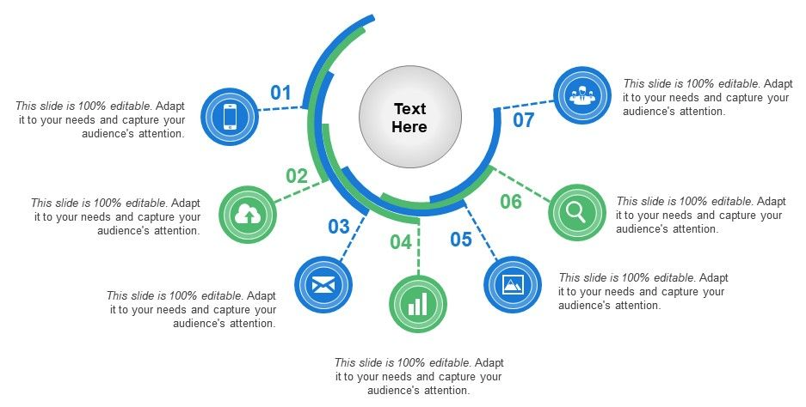
Women eligible for extended gestational period for termination of pregnancy from 20-24 weeks.
Survivors of Sexual Assault / Rape / Incest
Women with pregnancy in humanitarian settings/disaster/and/or emergency situations as declared by Government
Minors
The foetal malformation that has substantial risk of being incompatible with life or if the child was born it would suffer from such physical or mental abnormalities to be seriously handicapped
Mentally ill women including mental retardation
Change of marital status during the ongoing pregnancy
(widowhood and divorce)
Women with Physical Disabilities (major disability as per criteria under the Disability Act)
11-12-2022
Ministry of Health and Family Welfare, Government of India

Slide 56
11-12-2022
Ministry of Health and Family Welfare, Government of India
Functions of the Medical Boards:
To examine the woman and her reports, who would approach for medical termination of pregnancy
Provide the opinion of Medical Board in Form D with regard to the termination of pregnancy or rejection of request for termination within three days of receiving the request for medical termination of pregnancy
To ensure that the termination procedure, when advised by the Medical Board, is carried out with all safety precautions along with appropriate counselling within five days of the receipt of the request for medical termination of pregnancy

Slide 57
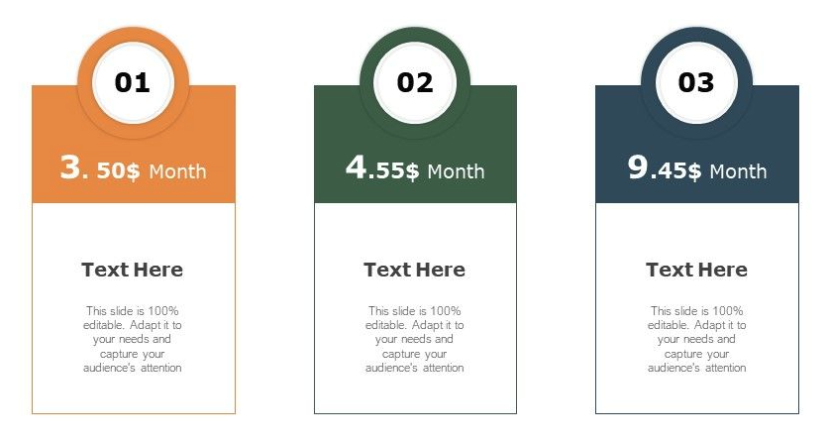
Place approved for MTP as per gestational age?
The gestation limit for DLC Approval for private facilities has been increased. With this changes now we have following gestation limits for which DLC can give approval.
Till 12 weeks
Till 24 weeks
Beyond 24 weeks
Note: Private facilities can perform abortion beyond 24 weeks only after the Medical Board opinion to termination the pregnancy beyond 24 weeks at the designated private facility with DLC approval.
Now Medical Methods of abortion can be used till 9 weeks of gestation limit in both public and private facilities.
Till 24 weeks
Beyond 24 weeks
Till 12 weeks
An operation table and instruments for performing abdominal or gynaecological surgery
Anaesthetic equipment, resuscitation equipment and sterilization equipment
Drugs and parental fluids for emergency use, notified by Government of India from time to time
An operation table and instruments for performing abdominal or gynaecological surgery
Anaesthetic equipment, resuscitation equipment and sterilization equipment
Availability of drugs, parental fluids and blood for emergency use, notified by Government of India from time to time
Facilities for procedure under Ultrasound guidance
A gynecology examination / labour table
Resuscitation and sterilization equipment
Drugs and parental fluid
Back up facilities for treatment of shock and
Facilities for transportation
11-12-2022
Ministry of Health and Family Welfare, Government of India

Slide 58
Thank you

